Slide 1
www.MINEPORTAL.in
ONLINE TEST SERIES FOR
DGMS COAL/METAL FIRST/SECOND CLASS EXAM
GATE MINING EXAM
OVERMAN EXAM TEST
MINING INSPECTOR EXAMS
COAL INDIA MTs & OTHER PSUs EXAMS
FREE STUDY MATERIAL & VIDEO LECTURES
MINING JOBS NOTIFICATIONS
www.mineportal.in Call/Whatsapp-8804777500 www.fb.com/mineportal.in

Slide 2
MINE DEVLOPMENT

Slide 3
GEOLOGICAL TERMINOLOGY
ORE
COAL SEAM
STRATA
HANGING WALL
FOOT WALL
MINERAL
HOST ROCK

Slide 5
GEOLOGICAL TERMINOLOGY
STRIKE LENGTH
STRIKE DIRECTION
DIP
FOLDS
FAULTS
JOINTS

Slide 6
ORE
IT IS A NATURAL AGGRIGATE OF ONE OR MORE MINERALS WHICH CAN BE USED FOR ECONOMICAL EXTRACTION OF METAL AFTER PROCESSING TO SEPRATE MINERAL FROM GANGUE.
Generally, the ore and the gangue are mined together—i.e., taken out of the host rock in a mass by either mechanical or manual means. Then the ore is separated from the gangue by various operations known collectively as mineral processing, or ore dressing. The desired metallic element is then extracted from the ore by various smelting, roasting, or leaching processes.

Slide 7
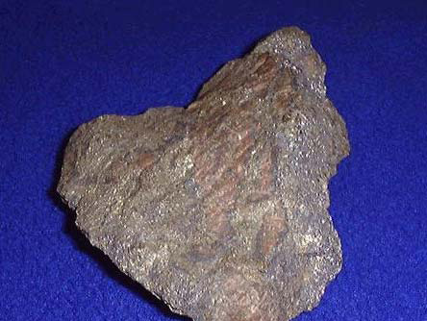
Although more than 2,800 mineral species have been identified, only about 100 are considered ore minerals. Among these are hematite, magnetite, limonite, and siderite, which are the principal sources of iron; chalcopyrite, bornite, and chalcocite, the principal sources of copper; and sphalerite and galena, the principal sources, respectively, of zinc and lead. Copper, molybdenum, and gold are commonly found in disseminated deposits—i.e., scattered more or less uniformly through a large volume of rock.

Slide 8
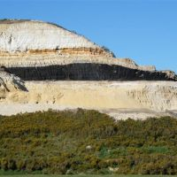
COAL SEAM
Coal seam – a seam of coal - a stratum of ore or coal thick enough to be mined with profit.

Slide 9
STRATA
sedimentary rock layer bounded by two stratification planes, the latter being produced by visible changes in the grain size, texture, or other diagnostic features of the rocks above and below the plane. A stratum that is less than one centimetre (0.4 inch) in thickness is termed a lamina, whereas one greater than this thickness is a bed.

Slide 10
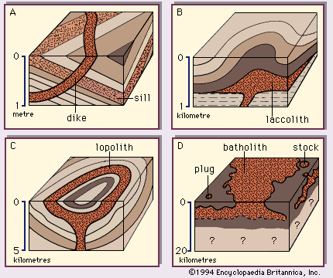

Slide 11
HANGING WALL & FOOT WALL
FOOT WALL
The block of rock lying under an inclined geologic fault plane.
The mass of rock underlying a mineral deposit in a mine.
HANGING WALL
The overlying block of a fault having an inclined fault plane.
The mass of rock overlying a mineral deposit in a mine.

Slide 12
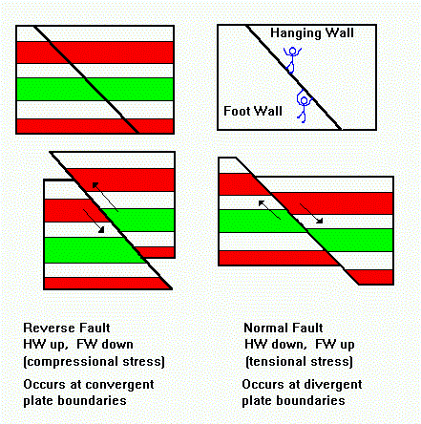

Slide 13
MINERAL
naturally occurring homogeneous solid with a definite chemical composition and a highly ordered atomic arrangement; it is usually formed by inorganic processes. There are several thousand known mineral species, about 100 of which constitute the major mineral components of rocks; these are the so-called rock-forming minerals.

Slide 14
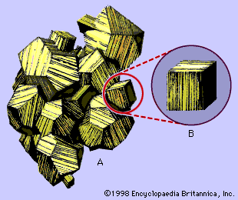

Slide 15

HOST ROCK
Rock which serves as a host for other rocks or for mineral deposits.
ruby stone in its host rock

Slide 16
STRIKE LENGTH & DIRECTION
direction of the line formed by the intersection of a fault, bed, or other planar feature and a horizontal plane. Strike indicates the attitude or position of linear structural features such as faults, beds, joints, and folds. Trend is the direction of the line formed by the intersection of the planar feature with the ground surface; trend is the same as strike only if the ground surface is parallel to the horizontal plane

Slide 17
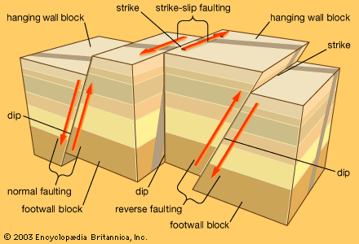

Slide 18
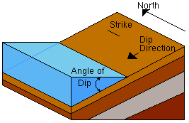
DIP
Dip is the angle of the bed with the horizontal plane.
The dip direction is perpendicular to the strike direction.

Slide 19
FOLDS
Stratified rocks were originally formed from sediments that were deposited in flat, horizontal sheets, but in a number of places the strata are no longer horizontal but have been warped. Sometimes the warping is so gentle that the inclination of the strata is barely perceptible, or the warping may be so pronounced that the strata of the two flanks may be essentially parallel or lie nearly flat (as in the case of a recumbent fold). Folds vary widely in size; some are several kilometres or even hundreds of kilometres across, and others measure just a few centimetres or less.

Slide 20
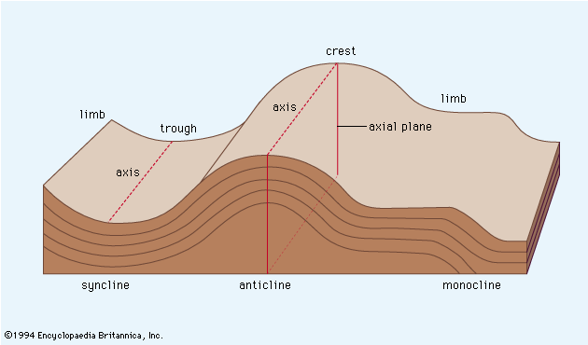

Slide 21
An anticline is a fold that is convex upward, and a syncline is a fold that is concave upward.
A symmetrical fold is one in which the axial plane is vertical. An asymmetrical fold is one in which the axial plane is inclined.

Slide 22
FAULTS
a planar or gently curved fracture in the rocks of the Earth's crust, where compressional or tensional forces cause relative displacement of the rocks on the opposite sides of the fracture.
Faults range in length from a few centimetres to many hundreds of kilometres, and displacement likewise may range from less than a centimetre to several hundred kilometres along the fracture surface (the fault plane).

Slide 23
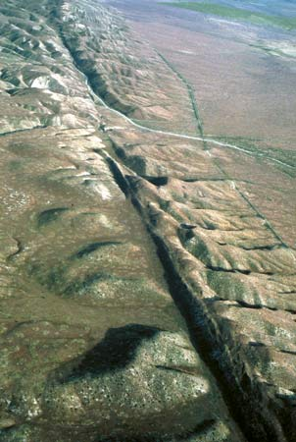

Slide 24
JOINTS
a brittle-fracture surface in rocks along which little or no displacement has occurred.
Present in nearly all surface rocks, joints extend in various directions, generally more toward the vertical than to the horizontal. Joints may have smooth, clean surfaces, or they may be scarred by slickensides, or striations.

Slide 25
MINE ENTRIES
Shaft
Incline
Decline
Ramp
Adit

Slide 26
SHAFT
All the early coal seams were worked from the surface, in fully exposed outcroppings. In the later Middle Ages, however, exhaustion of outcrop coal in many places forced a change from surface to underground, or shaft, mining.
shafts had to be restricted to depths of 90 to 105 metres (300 to 350 feet) and a mining radius of 180 metres.

Slide 27
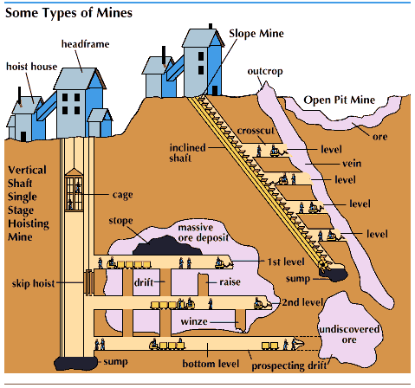

Slide 28
INCLINE

Slide 29
ADIT
a horizontal or near-horizontal passage driven from the Earth's surface into the side of a ridge or mountain for the purpose of working, ventilating, or removing water from a mine.
the generally lower cost of driving an adit, the saving in the cost of pumping water, and the ease of hoisting ore through the shaft dictate in favour of the adit.
Adits as long as one to three kilometres (one or two miles) are often economically feasible.
The size and cross section of an adit depend upon its use, with a horseshoe shape especially common. The walls may be of the natural rough rock or may be lined with concrete, wood, or steel.

Slide 30
